Slide 1


Introduction to Kafka
Dr. Rajiv Misra
Dept. of Computer Science & Engg.
Indian Institute of Technology Patna
rajivm@iitp.ac.in
Big Data Computing
Introduction to Kafka

Slide 2
Preface
Content of this Lecture:
Define Kafka
Use cases for Kafka
Kafka data model
Kafka architecture
Types of messaging systems
Importance of brokers
Big Data Computing
Introduction to Kafka

Slide 3


Batch vs. Streaming
Batch
Streaming
Big Data Computing
Introduction to Kafka

Slide 4
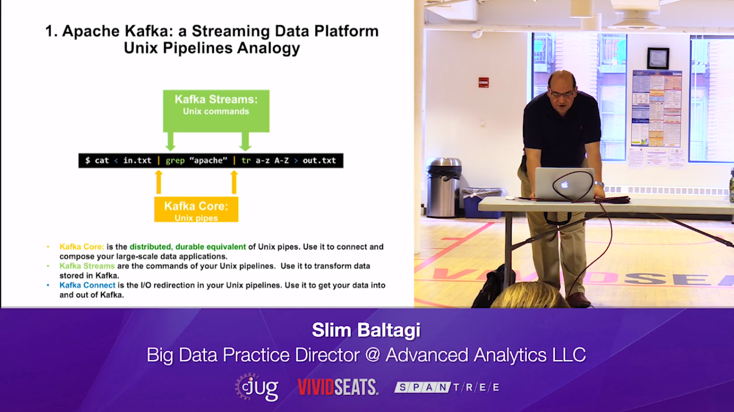

Slide 5
Introduction: Apache Kafka
Kafka is a high-performance, real-time messaging system. It is an open source tool and is a part of Apache projects.
The characteristics of Kafka are:
It is a distributed and partitioned messaging system.
It is highly fault-tolerant
It is highly scalable.
It can process and send millions of messages per second to several receivers.
Big Data Computing
Introduction to Kafka

Slide 6
Kafka History
Apache Kafka was originally developed by LinkedIn and later, handed over to the open source community in early 2011.
It became a main Apache project in October, 2012.
A stable Apache Kafka version 0.8.2.0 was release in Feb, 2015.
A stable Apache Kafka version 0.8.2.1 was released in May, 2015, which is the latest version.
Big Data Computing
Introduction to Kafka

Slide 7
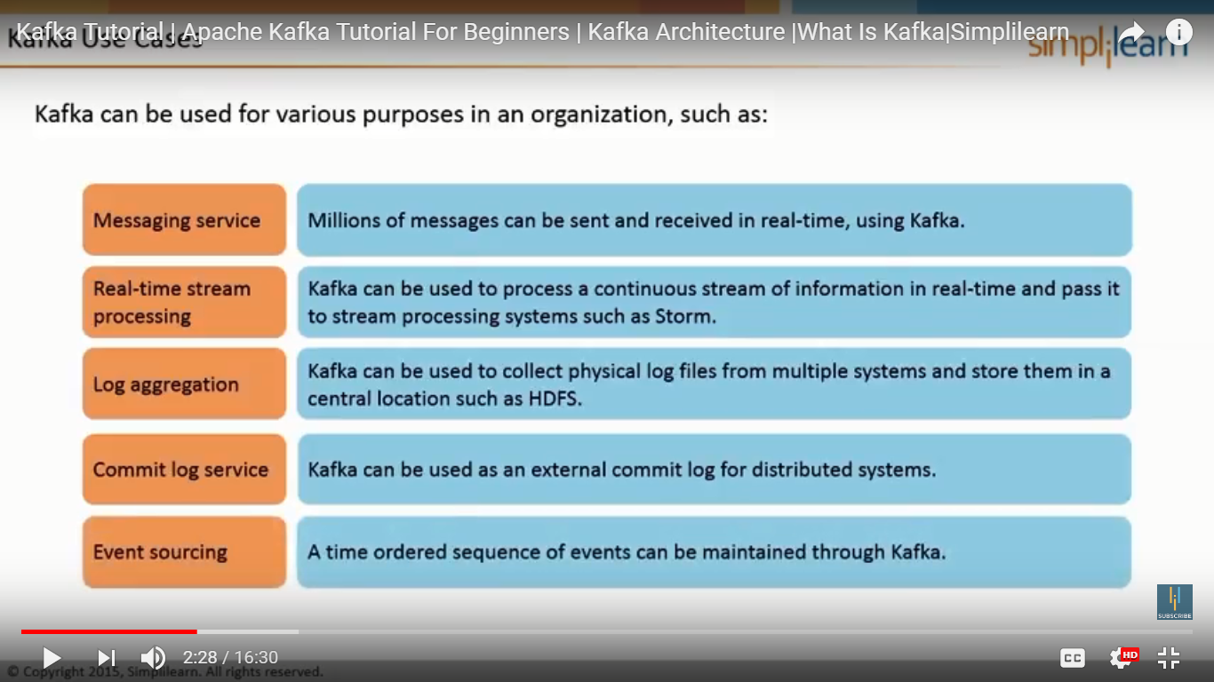

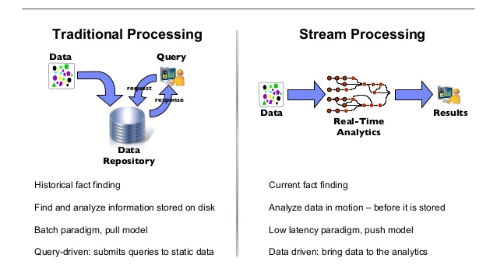
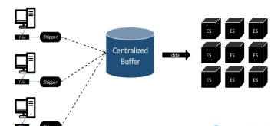
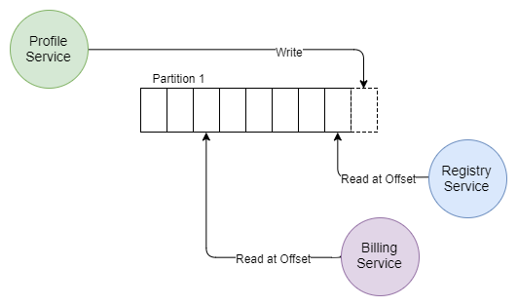
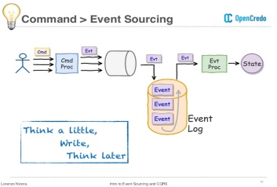
Kafka Use Cases
Kafka can be used for various purposes in an organization, such as:
Big Data Computing
Introduction to Kafka

Slide 8
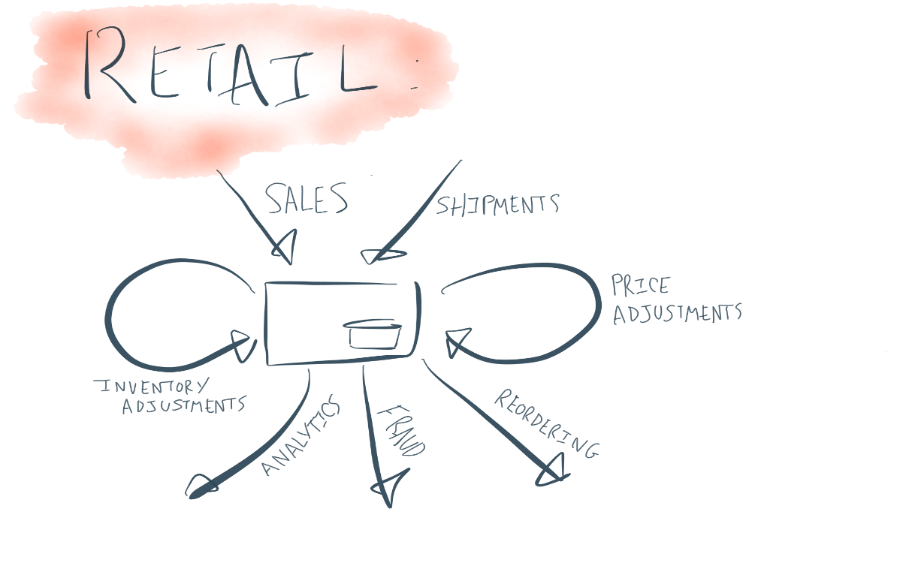
Apache Kafka: a Streaming Data Platform
Most of what a business does can be thought as event streams. They are in a
Retail system: orders, shipments, returns, …
Financial system: stock ticks, orders, …
Web site: page views, clicks, searches, …
IoT: sensor readings, …
and so on.
Big Data Computing
Introduction to Kafka

Slide 9

Enter Kafka
Adopted at 1000s of companies worldwide
Big Data Computing
Introduction to Kafka

Slide 10
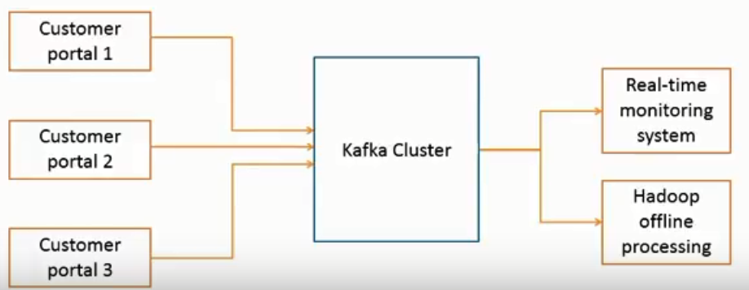
Aggregating User Activity Using Kafka-Example
Kafka can be used to aggregate user activity data such as clicks, navigation, and searches from different websites of an organization; such user activities can be sent to a real-time monitoring system and hadoop system for offline processing.
Big Data Computing
Introduction to Kafka

Slide 11
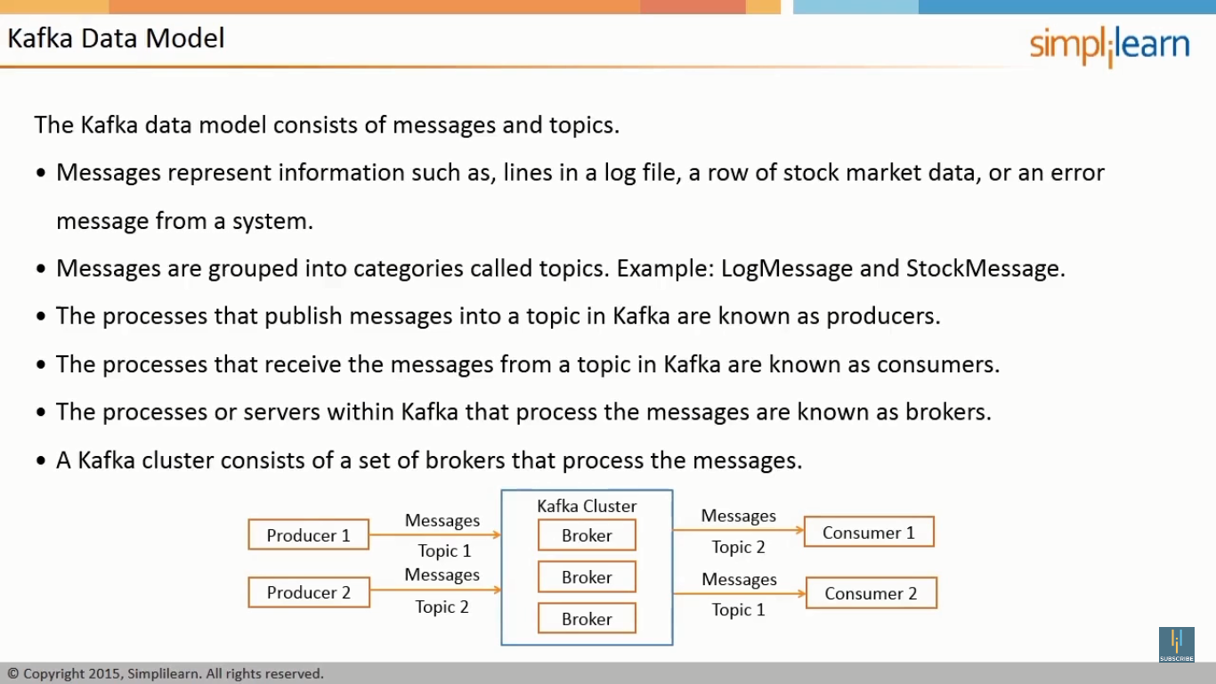
Kafka Data Model
The Kafka data model consists of messages and topics.
Messages represent information such as, lines in a log file, a row of stock market data, or an error message from a system.
Messages are grouped into categories called topics. Example: LogMessage and Stock Message.
The processes that publish messages into a topic in Kafka are known as producers.
The processes that receive the messages from a topic in Kafka are known as consumers.
The processes or servers within Kafka that process the messages are known as brokers.
A Kafka cluster consists of a set of brokers that process the messages.
Introduction to Kafka

Slide 12
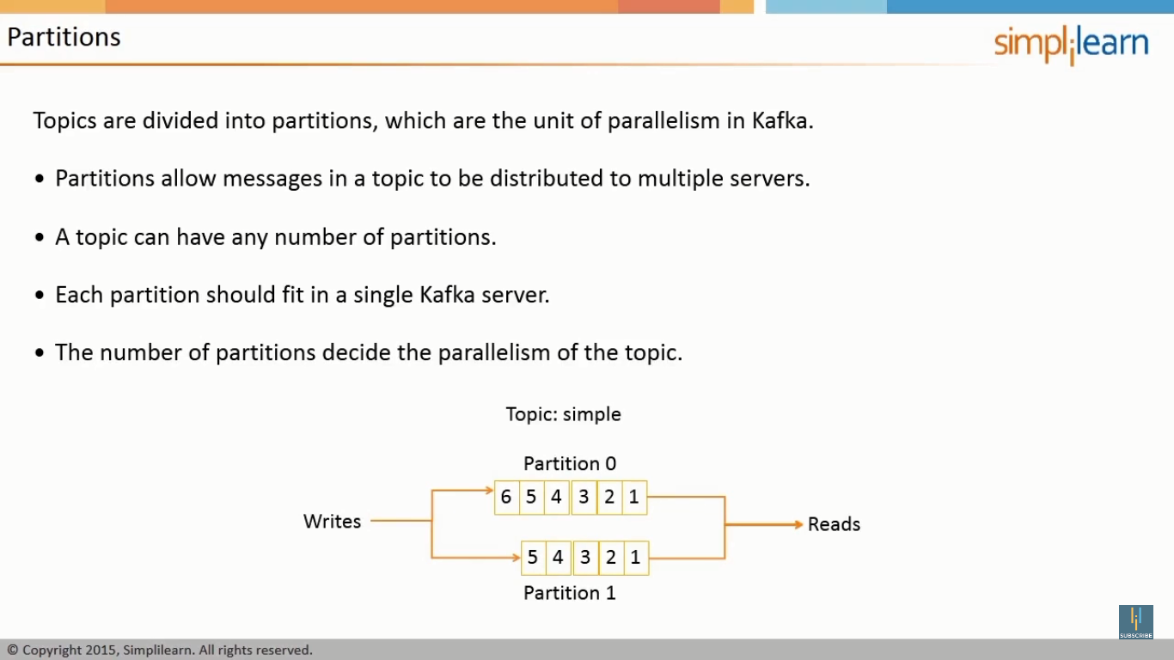
Topics
A topic is a category of messages in Kafka.
The producers publish the messages into topics.
The consumers read the messages from topics.
A topic is divided into one or more partitions.
A partition is also known as a commit log.
Each partition contains an ordered set of messages.
Each message is identified by its offset in the partition.
Messages are added at one end of the partition and consumed at the other.
Big Data Computing
Introduction to Kafka

Slide 13
Partitions
Topics are divided into partitions, which are the unit of parallelism in Kafka.
Partitions allow messages in a topic to be distributed to multiple servers.
A topic can have any number of partitions.
Each partition should fit in a single Kafka server.
The number of partitions decide the parallelism of the topic.
Big Data Computing
Introduction to Kafka

Slide 14
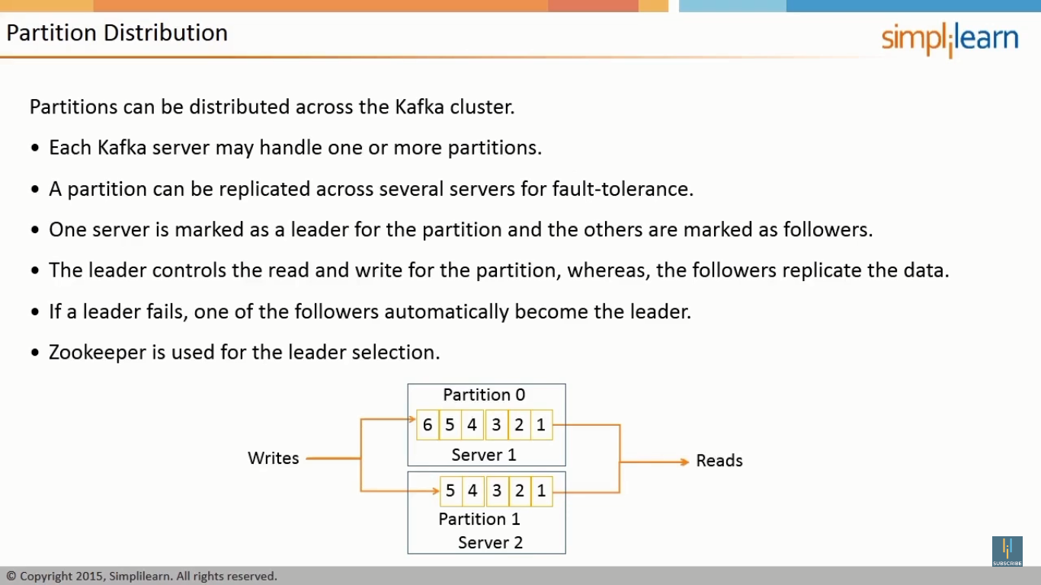
Partition Distribution
Partitions can be distributed across the Kafka cluster.
Each Kafka server may handle one or more partitions.
A partition can be replicated across several servers fro fault-tolerance.
One server is marked as a leader for the partition and the others are marked as followers.
The leader controls the read and write for the partition, whereas, the followers replicate the data.
If a leader fails, one of the followers automatically become the leader.
Zookeeper is used for the leader selection.
Big Data Computing
Introduction to Kafka

Slide 15
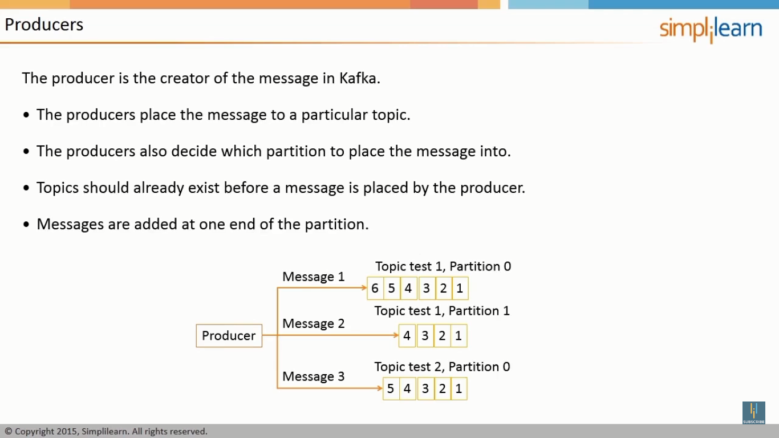
Producers
The producer is the creator of the message in Kafka.
The producers place the message to a particular topic.
The producers also decide which partition to place the message into.
Topics should already exist before a message is placed by the producer.
Messages are added at one end of the partition.
Big Data Computing
Introduction to Kafka

Slide 16
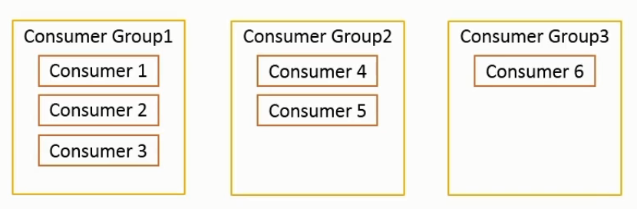
Consumers
The consumer is the receiver of the message in Kafka.
Each consumer belongs to a consumer group.
A consumer group may have one or more consumers.
The consumers specify what topics they want to listen to.
A message is sent to all the consumers in a consumer group.
The consumer groups are used to control the messaging system.
Big Data Computing
Introduction to Kafka

Slide 17
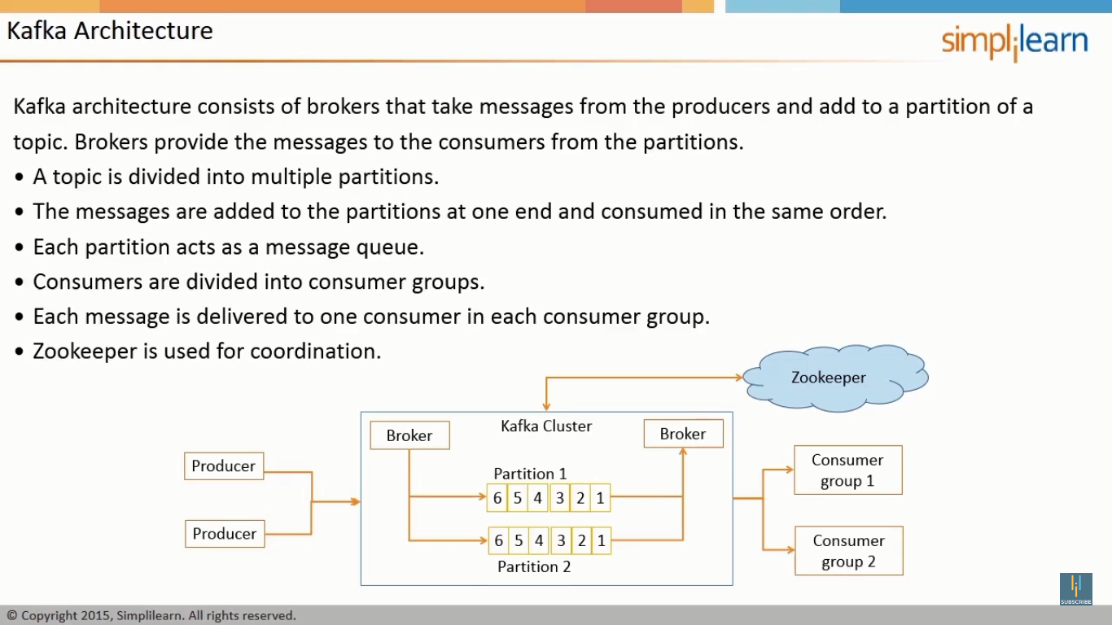
Kafka Architecture
Kafka architecture consists of brokers that take messages from the producers and add to a partition of a topic. Brokers provide the messages to the consumers from the partitions.
A topic is divided into multiple partitions.
The messages are added to the partitions at one end and consumed in the same order.
Each partition acts as a message queue.
Consumers are divided into consumer groups.
Each message is delivered to one consumer in each consumer group.
Zookeeper is used for coordination.
Big Data Computing
Introduction to Kafka

Slide 18
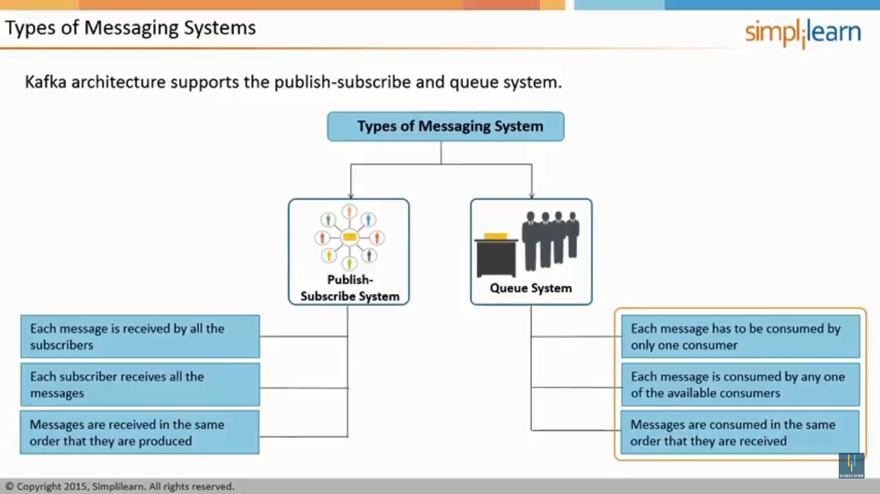
Types of Messaging Systems
Kafka architecture supports the publish-subscribe and queue system.
Big Data Computing
Introduction to Kafka

Slide 19
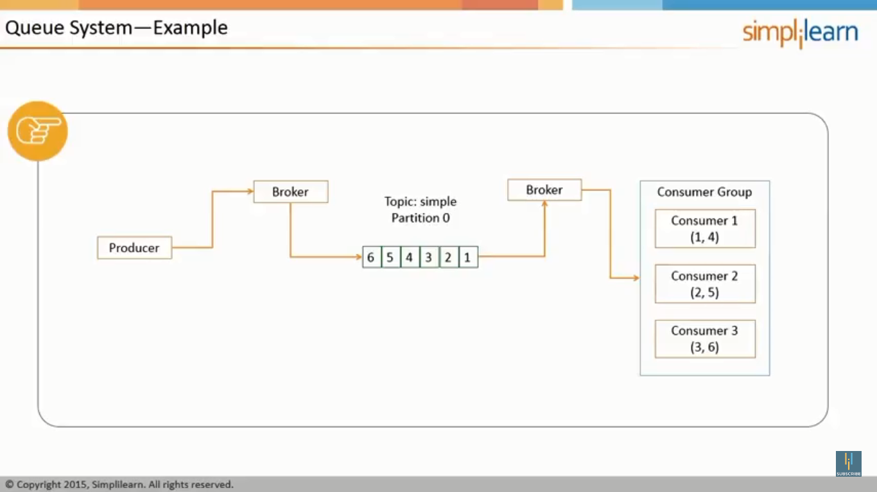
Example: Queue System
Big Data Computing
Introduction to Kafka

Slide 20
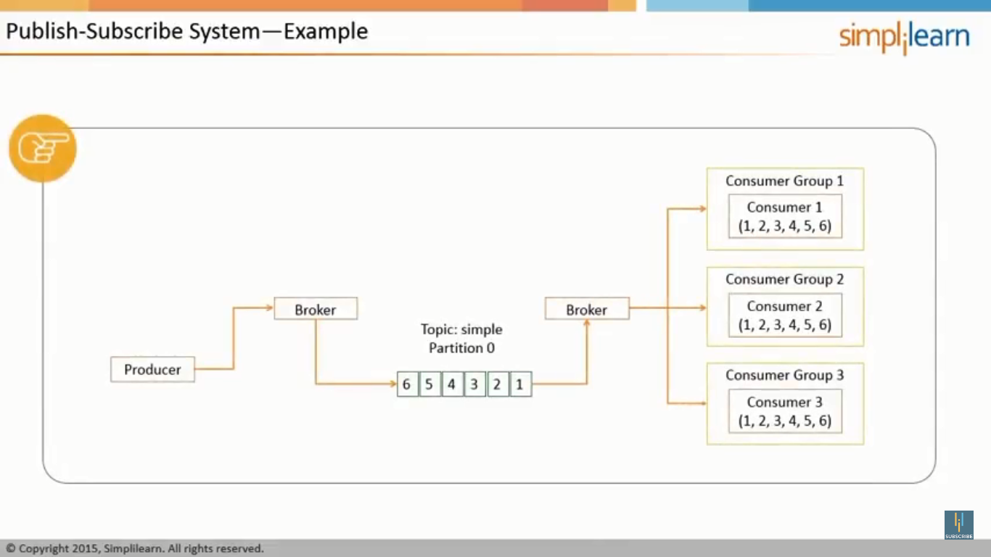
Example: Publish-Subscribe System
Big Data Computing
Introduction to Kafka

Slide 21
Brokers
Brokers are the Kafka processes that process the messages in Kafka.
Each machine in the cluster can run one broker.
They coordinate among each other using Zookeeper.
One broker acts as a leader for a partition and handles the delivery and persistence, where as, the others act as followers.
Big Data Computing
Introduction to Kafka

Slide 22
Kafka Guarantees
Kafka guarantees the following:
Messages sent by a producer to a topic and a partition are appended in the same order
A consumer instance gets the messages in the same order as they are produced.
A topic with replication factor N, tolerates upto N-1 server failures.
Big Data Computing
Introduction to Kafka

Slide 23
Replication in Kafka
Kafka uses the primary-backup method of replication.
One machine (one replica) is called a leader and is chosen as the primary; the remaining machines (replicas) are chosen as the followers and act as backups.
The leader propagates the writes to the followers.
The leader waits until the writes are completed on all the replicas.
If a replica is down, it is skipped for the write until it comes back.
If the leader fails, one of the followers will be chosen as the new leader; this mechanism can tolerate n-1 failures if the replication factor is ‘n’
Big Data Computing
Introduction to Kafka

Slide 24
Persistence in Kafka
Kafka uses the Linux file system for persistence of messages
Persistence ensures no messages are lost.
Kafka relies on the file system page cache for fast reads and writes.
All the data is immediately written to a file in file system.
Messages are grouped as message sets for more efficient writes.
Message sets can be compressed to reduce network bandwidth.
A standardized binary message format is used among producers, brokers, and consumers to minimize data modification.
Big Data Computing
Introduction to Kafka

Slide 25
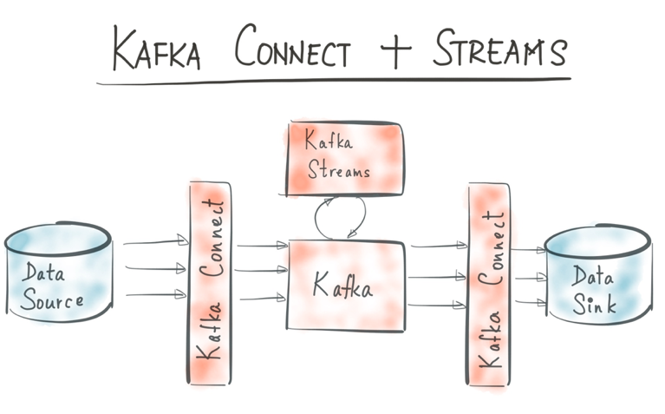
Apache Kafka: a Streaming Data Platform
Apache Kafka is an open source streaming data platform (a new category of software!) with 3 major components:
Kafka Core: A central hub to transport and store event streams in real-time.
Kafka Connect: A framework to import event streams from other source data systems into Kafka and export event streams from Kafka to destination data systems.
Kafka Streams: A Java library to process event streams live as they occur.
Big Data Computing
Introduction to Kafka

Slide 26
Further Learning
Kafka Streams code examples
Apache Kafka https://github.com/apache/kafka/tree/trunk/streams/examples/src/main/java/org/apache/kafka/streams/examples
Confluent https://github.com/confluentinc/examples/tree/master/kafka-streams
Source Code https://github.com/apache/kafka/tree/trunk/streams
Kafka Streams Java docs http://docs.confluent.io/current/streams/javadocs/index.html
First book on Kafka Streams (MEAP)
Kafka Streams in Action https://www.manning.com/books/kafka-streams-in-action
Kafka Streams download
Apache Kafka https://kafka.apache.org/downloads
Confluent Platform http://www.confluent.io/download
Big Data Computing
Introduction to Kafka

Slide 27
Conclusion
Kafka is a high-performance, real-time messaging system.
Kafka can be used as an external commit log for distributed systems.
Kafka data model consists of messages and topics.
Kafka architecture consists of brokers that take messages from the producers and add to a partition of a topics.
Kafka architecture supports two types of messaging system called publish-subscribe and queue system.
Brokers are the Kafka processes that process the messages in Kafka.
Big Data Computing
Introduction to Kafka

